Slide 1



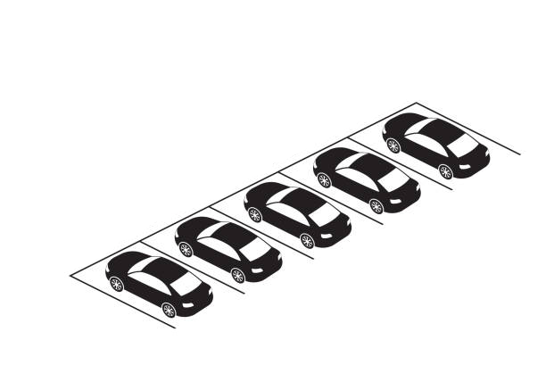

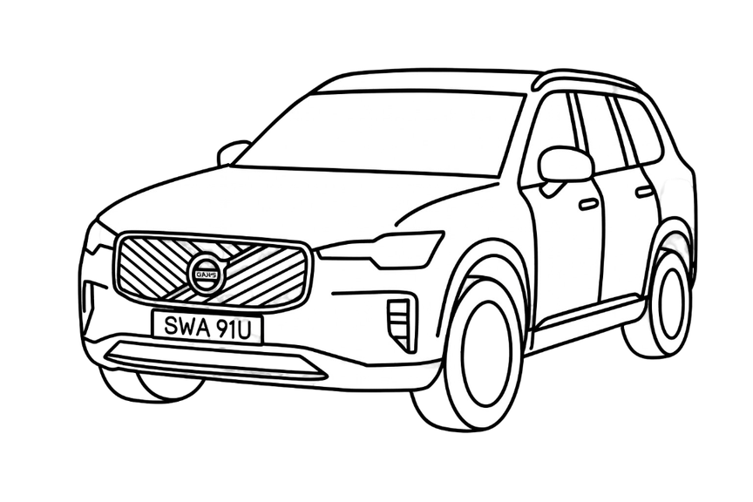

ATU FINAL YEAR PROJECT
SEAN MALONEY
GITHUB
PARKING FINDER
SUMMER DEMO
The most efficient problem for tackling modern problems is using modern solutions.

Slide 2
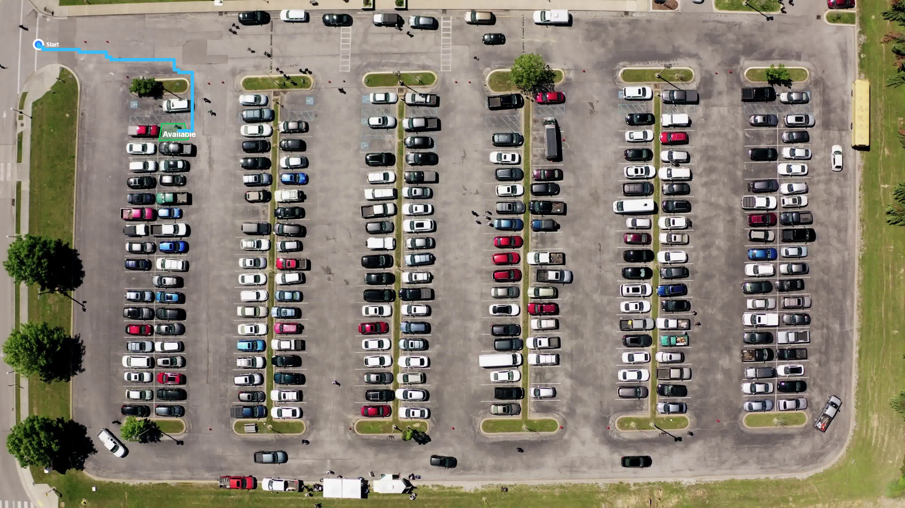
ATU FINAL YEAR PROJECT
SEAN MALONEY
PAGE 02
THE PROJECT OVERVIEW
Smart parking prototype using AI and computer vision
Detects vehicles and classifies spaces as free or occupied
Built with YOLOv8, Raspberry Pi, FastAPI, MongoDB, and Next.js
Includes parking visualisation and A* route generation
Designed as a low-cost parking assistance solution

Slide 3
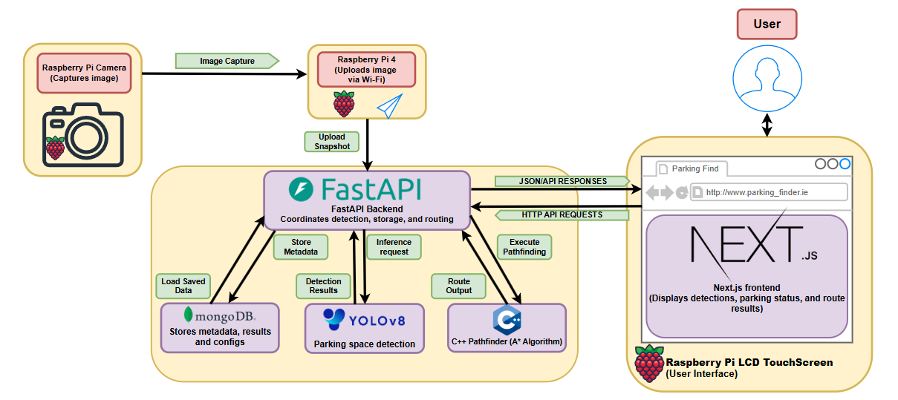
ATU FINAL YEAR PROJECT
SEAN MALONEY
PAGE 03
SYSTEM OVERVIEW
FINAL ARCHITECTURE
DIAGRAM
Parking Finder is a smart parking system that integrates image capture, AI detection, parking analysis, and route generation.
01
IMAGE CAPTURE & UPLOAD
02
A Raspberry Pi camera captures parking images, and the Raspberry Pi 4 uploads them to the backend over Wi-Fi.
02
BACKEND, AI & ROUTING
03
FastAPI manages the core logic, connecting MongoDB storage, YOLOv8 vehicle detection, and C++ A* pathfinding.
03
USER INTERACTION & OUTPUT
04
A Next.js frontend on a Raspberry Pi LCD touchscreen displays parking status, detections, and route results to the user.
04

Slide 4
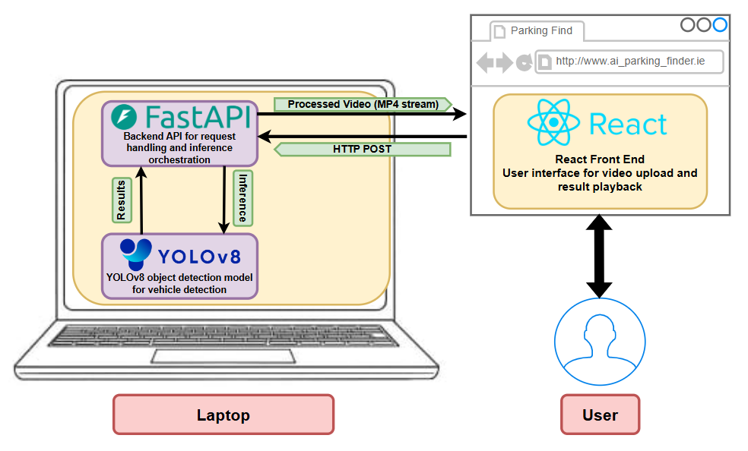
ATU FINAL YEAR PROJECT
SEAN MALONEY
PAGE 04
PI INTEGRATION
WHAT’S NEW SINCE CHRISTMAS DEMO?
01
Added Raspberry Pi camera capture, Raspberry Pi 4 upload flow, and LCD touchscreen support.
DATABASE & STORAGE
02
Integrated MongoDB for persistent storage of parking configurations, metadata, and capture data.
02
PARKING ANALYSIS & ROUTING
03
03
Added parking polygon configuration, occupancy classification, and C++ A* pathfinding to generate routes to available spaces.
FRONTEND & SYSTEM IMPROVEMENTS
04
Redesigned the frontend with an Ookla Speedtest inspired layout and improved overall system integration across hardware, backend, AI, and routing.
04

Slide 5
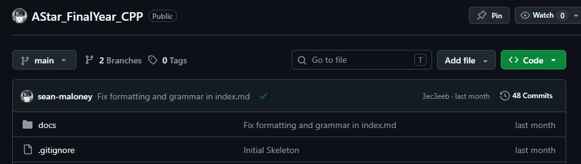
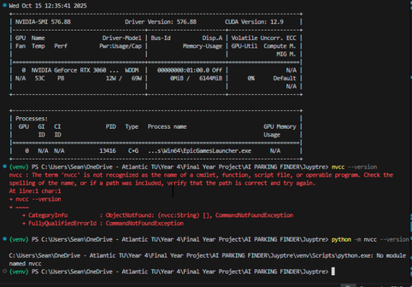
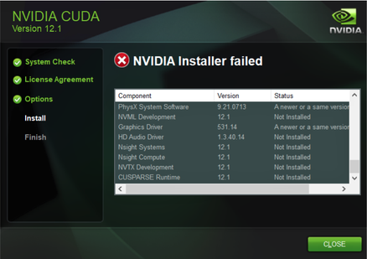
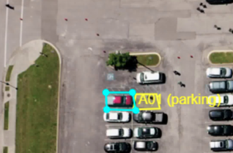

ATU FINAL YEAR PROJECT
SEAN MALONEY
PAGE 05
CHALLANGES AND SOLLUTIONS
GPU TRAINING & CUDA COMPATIBILITY
Challenge: Training was initially on CPU instead of GPU due to CUDA, PyTorch, and driver version mismatches.
Solution: Researched CUDA compatibility matrices, aligned software versions to successfully enable GPU.
01
CAMERA APPROACH & SYSTEM DIRECTRION
Challenge: The original drone based idea was not practical for a realistic parking deployment.
Solution: Redesigned around a fixed elevated camera for a more practical and reliable solution.
02
OCCUPANCY CLASSIFICATION
Challenge: Vehicle detection alone could not identify free spaces.
Solution: Parking polygons were added for space classification.
03
PATHFINDING & GRID SETUP
Challenge: Route generation depended on accurate grid mapping.
Solution: A C++ A* system was integrated for routing.
04

Slide 6
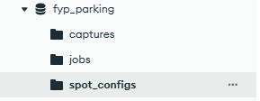
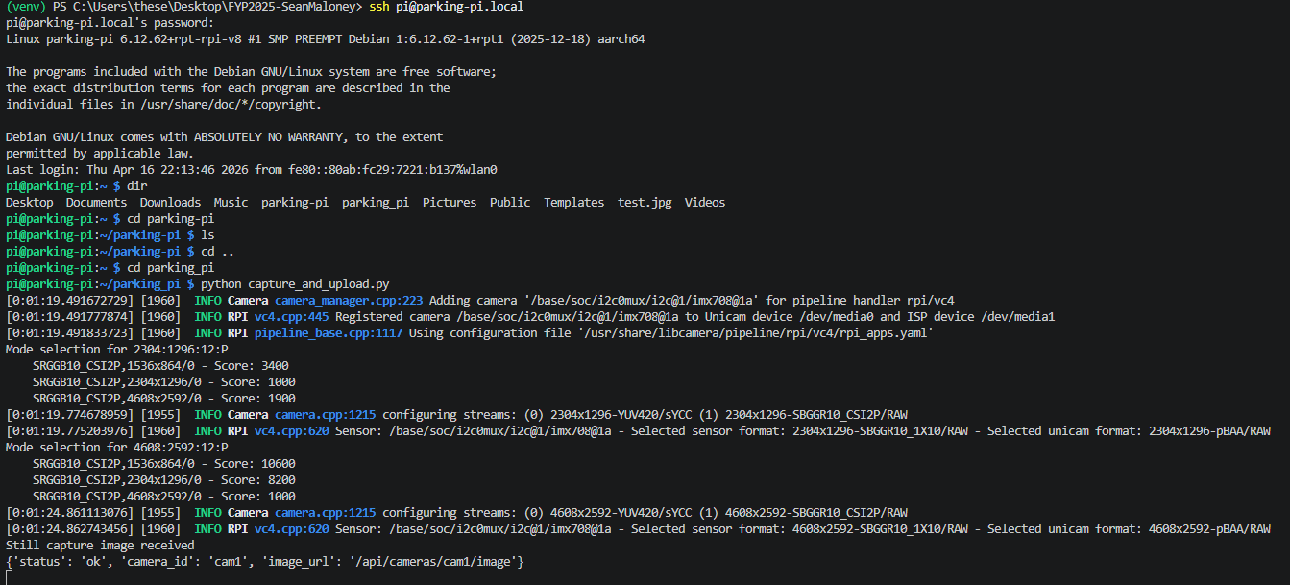
ATU FINAL YEAR PROJECT
SEAN MALONEY
PAGE 06
Parking space configuration
Occupied vs free space detection
A* route generation
Grid layout mapping
MongoDB data storage
Raspberry Pi integration
RESEARCH

Slide 7
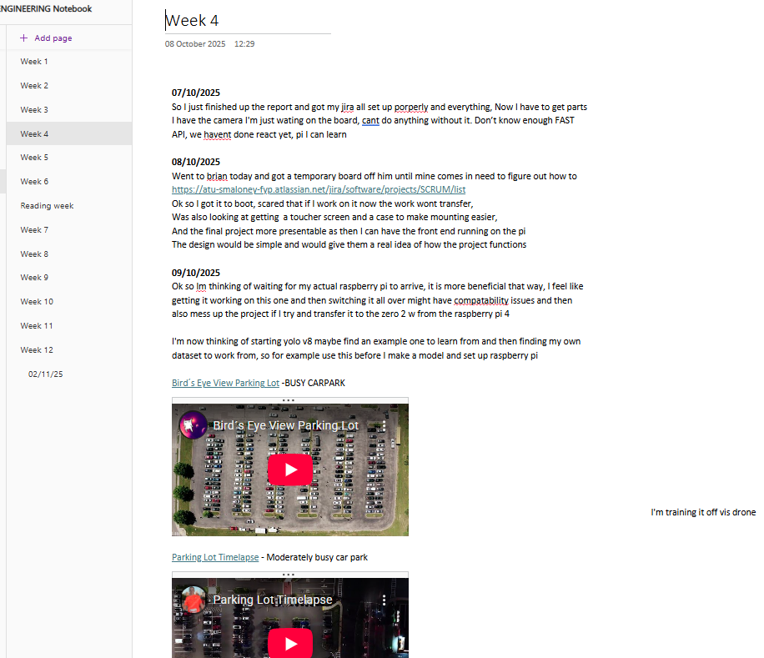
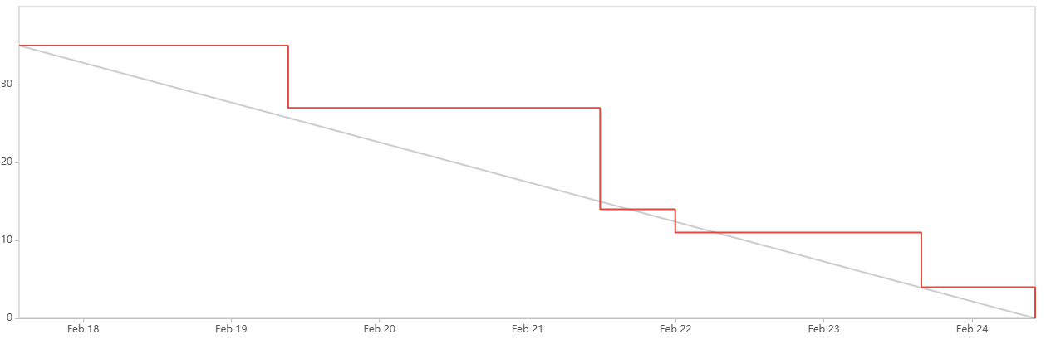
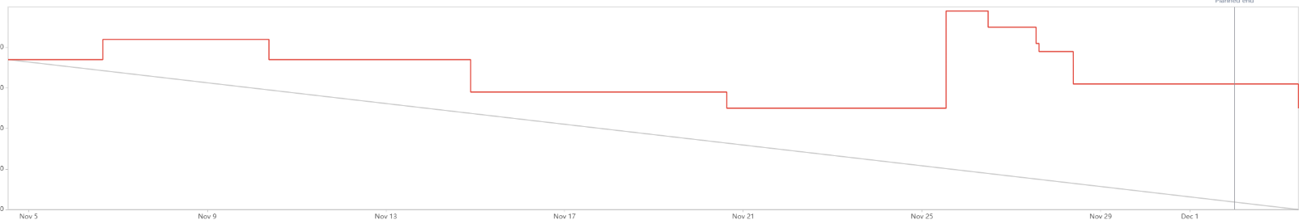
ATU FINAL YEAR PROJECT
SEAN MALONEY
PAGE 07
PROJECT MANAGEMENT 1
SEMESTER 2
VS
SEMESTER 1

Slide 8
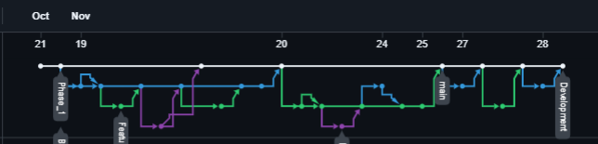
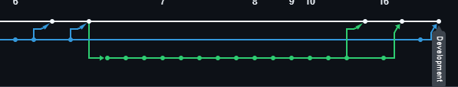
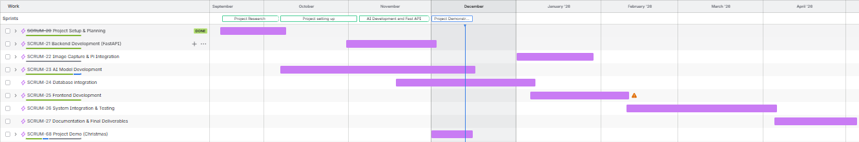
ATU FINAL YEAR PROJECT
SEAN MALONEY
PAGE 08
Sprint based development
Clear improvement from Semester 1→ Semester 2
Better task breakdown and estimation over time
Moved to 2/1 week sprints for easier management
Gannt chart used for easier planning.
Jira used to track sprint progress and priorities
GitHub network reflects improving and structured workflow
OneNote used to document project progress
PROJECT MANAGEMENT 2

Slide 9
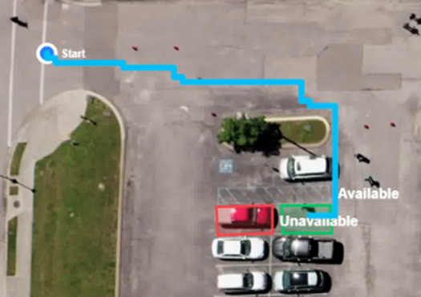
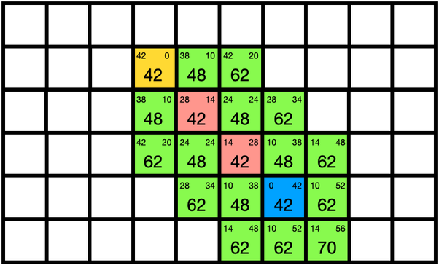
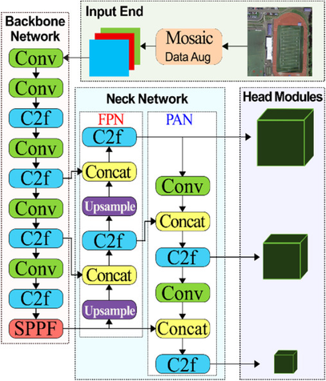
ATU FINAL YEAR PROJECT
SEAN MALONEY
PAGE 09
YOLO AND A*
C++ A* Algorithm Pathfinder
A* is a pathfinding algorithm used to find the shortest or most efficient path between two points.
It works by comparing the cost already travelled with an estimate of the cost remaining to the goal.
01
YOLOv8 Vehicle Detection
YOLOv8 is an object detection model used to identify and locate objects within an image.
It works by predicting bounding boxes and class labels in a single pass, making it fast and effective for real time detection.
02

Slide 10
ATU FINAL YEAR PROJECT
SEAN MALONEY
PAGE 10
AI DECLERATION
·Generative AI tools were used as support tools during the preparation of this project.
·AI assistance, where used, was used for tasks such as brainstorming, language refinement, formatting support, structure planning, debugging, generation of code, rewriting of code, and web scraping information not easily found.
·All technical design, implementation, testing, evaluation, and final written content were reviewed, validated, and approved by the author.
·The author takes full responsibility for the accuracy, originality, and academic integrity of this submission.

Slide 11
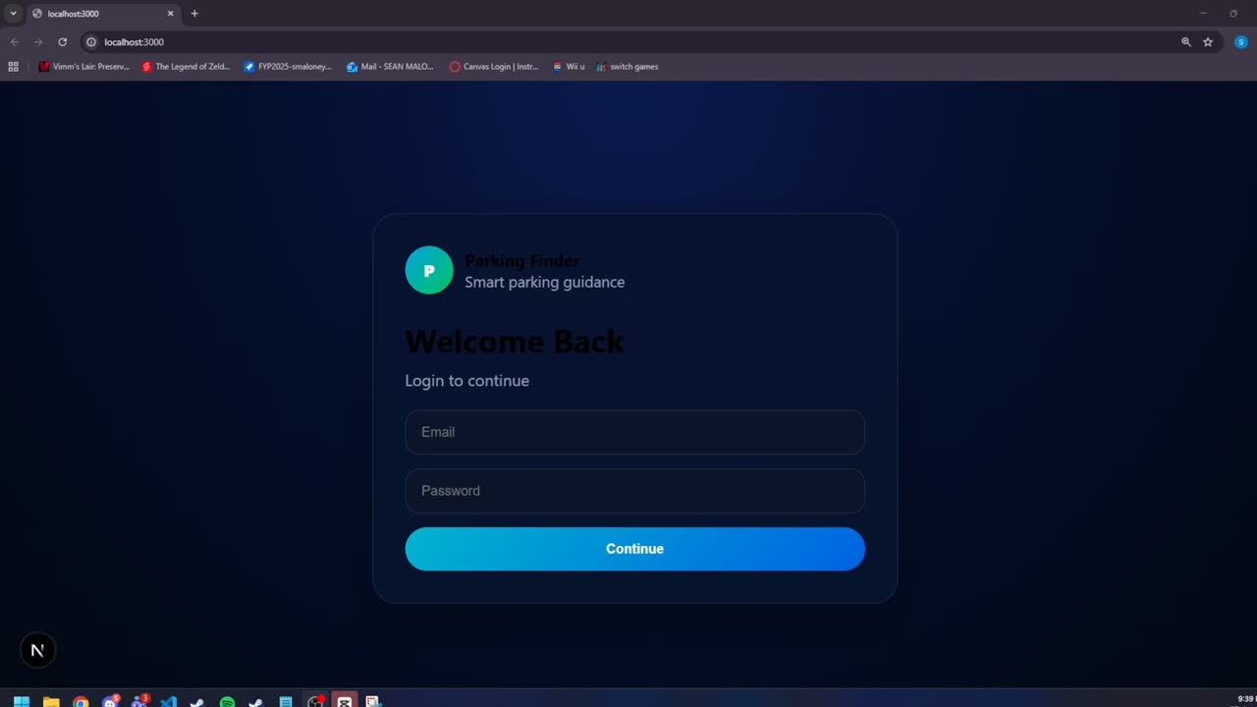
ATU FINAL YEAR PROJECT
SEAN MALONEY
PAGE 11
DEMO VIDEO

